Slide 1
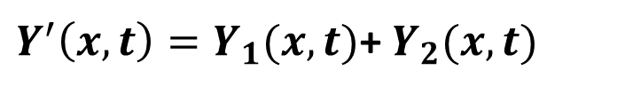
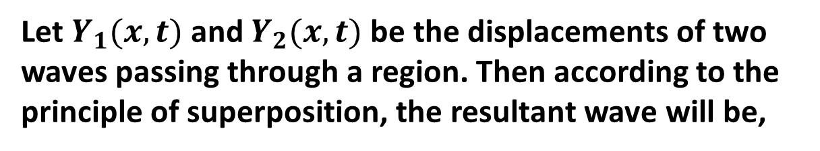
Principle of Superposition for Waves
Let $Y_{1}(x,t)$and $Y_{2}(x,t)$ be the displacements of two waves passing through a region. Then according to the principle of superposition, the resultant wave will be,
$Y^{′}\left(x,t\right)=Y_{1}(x,t)$+ $Y_{2}(x,t)$

Slide 2


Interference of Waves: The phenomenon of combining waves is called interference of waves.
$$Y_{1}\left(x,t\right)=Y_{m} Sin\left(kx−ωt\right)$$
$$Y_{2}\left(x,t\right)=Y_{m} Sin(kx−ωt+φ)$$
So, the resultant Wave,
$$Y^{′}\left(x,t\right)=Y_{1}(x,t)\text{+ }Y_{2}(x,t)$$
$$Y^{′}\left(x,t\right)=Y_{m} Sin\left(kx−ωt\right)+Y_{m} Sin(kx−ωt+φ)$$
$$Y^{′}\left(x,t\right)=Y_{m}[Sin\left(kx−ωt\right)+Sin\left(kx−ωt+φ\right)]$$

Slide 3

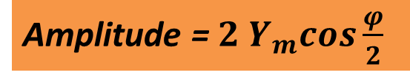
$$Y^{′}\left(x,t\right)=Y_{m} 2 Sin\frac{kx−ωt+kx−ωt+φ}{2} cos\frac{kx−ωt−kx+ωt−φ}{2}$$
$$Y^{′}\left(x,t\right)={2 Y}_{m}cos\frac{φ}{2}Sin\frac{2(kx−ωt)+φ}{2}$$
Amplitude =${ 2 Y}_{m}cos\frac{φ}{2}$

Slide 4
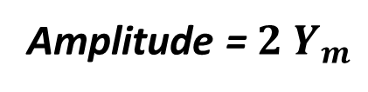



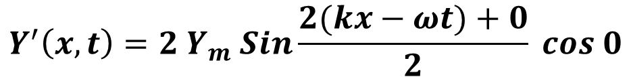
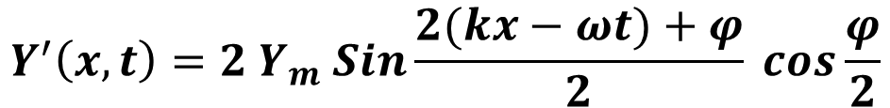
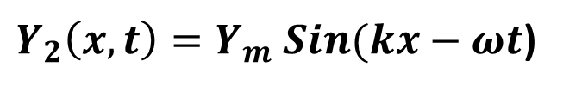
$$φ=0$$
$$Y_{1}\left(x,t\right)=Y_{m} Sin\left(kx−ωt\right)$$
$Y_{2}\left(x,t\right)=Y_{m} Sin(kx−ωt$)
And the resultant Wave,
$$Y^{′}\left(x,t\right)={2 Y}_{m} Sin\frac{2(kx−ωt)+φ}{2} cos\frac{φ}{2}$$
$$Y^{′}\left(x,t\right)={2 Y}_{m} Sin\frac{2(kx−ωt)+0}{2} cos 0$$
$${Y^{′}\left(x,t\right)=2Y}_{m} Sin\left(kx−ωt\right)$$
Amplitude =${ 2 Y}_{m}$

Slide 5
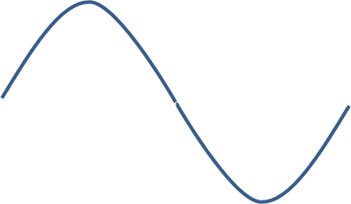
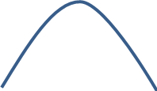
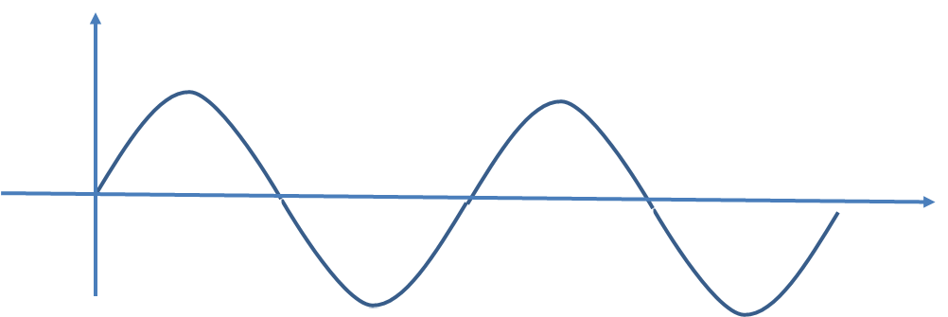

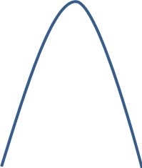

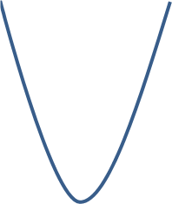



$$Y_{1}\left(x,t\right)$$
$$x$$
$$Y_{2}\left(x,t\right)$$
$$Y^{′}(x,t)$$

Slide 6



$$φ=π$$
$$Y_{1}\left(x,t\right)=Y_{m} Sin\left(kx−ωt\right)$$
$$Y_{2}\left(x,t\right)=Y_{m} Sin\left(kx−ωt+π\right)$$
$$Y^{′}\left(x,t\right)={2 Y}_{m}cos\frac{π}{3}Sin\frac{2(kx−ωt)+π}{2}]$$
$$Y^{′}\left(x,t\right)=0$$
Amplitude = 0

Slide 7
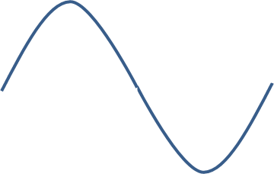
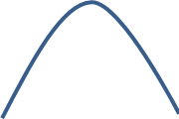
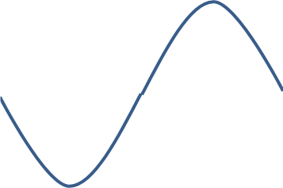






$$Y_{1}\left(x,t\right)$$
$$x$$
$$Y_{2}\left(x,t\right)$$
$$x$$
$$Y^{′}(x,t)$$
$$x$$

Slide 8

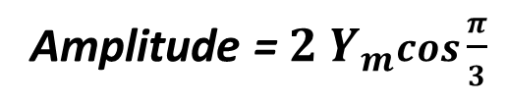
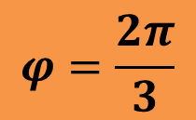
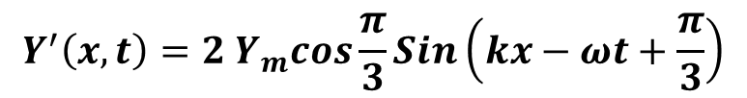

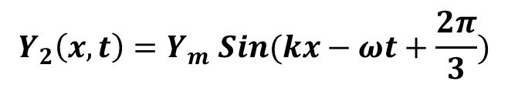
$$φ=\frac{2π}{3}$$
$$Y_{1}\left(x,t\right)=Y_{m} Sin\left(kx−ωt\right)$$
$$Y_{2}\left(x,t\right)=Y_{m} Sin(kx−ωt+\frac{2π}{3})$$
$$Y^{′}\left(x,t\right)={2 Y}_{m} Sin\frac{2(kx−ωt)+\frac{2π}{3}}{2} cos\frac{\frac{2π}{3}}{2}]$$
$$Y^{′}\left(x,t\right)={2 Y}_{m}cos\frac{π}{3}Sin\left(kx−ωt+\frac{π}{3}\right)$$
Amplitude =${ 2 Y}_{m}cos\frac{π}{3}$

Slide 9
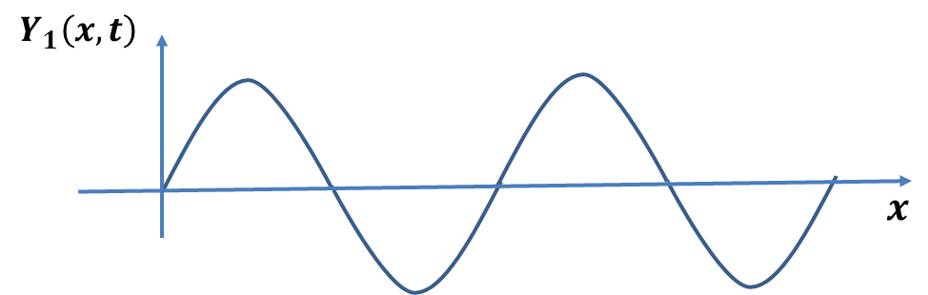

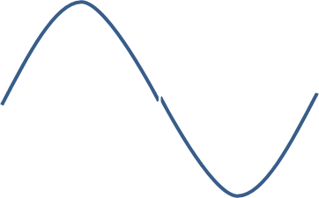
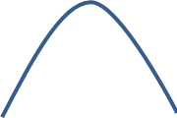
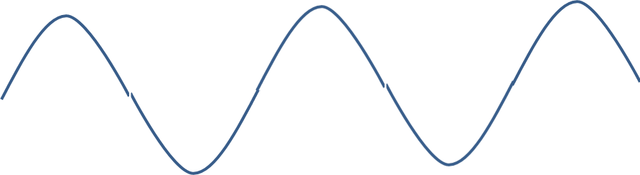




$$Y_{2}\left(x,t\right)$$
$$x$$
$$Y^{′}(x,t)$$
$$x$$

Slide 10


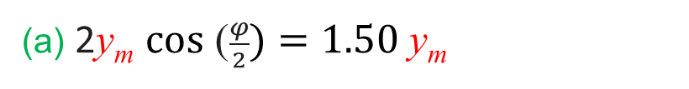


32. What phase difference between two identical traveling waves, moving in the same direction along a stretched string, results in the combined wave having an amplitude 1.50 times that of the common amplitude of the two combining waves? Express your answer in (a) degrees, (b) radians, and (c) wavelengths.
(a) 2y_{m} $\text{cos}\text{ (}\frac{φ}{2})=1.50 \text{y}\text{m}$
$$φ=\text{ 82.82}\text{0}$$
$$\left(b\right)φ=\text{ 1.45 }\text{rad} \text{Ans}\text{.}$$
$$\left(c\right) 2π rad= λ$$
$$1.45 rad=1.45\left(\frac{λ}{2π}\right)=0.23λ$$

Slide 11
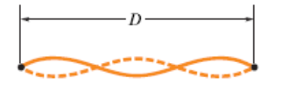
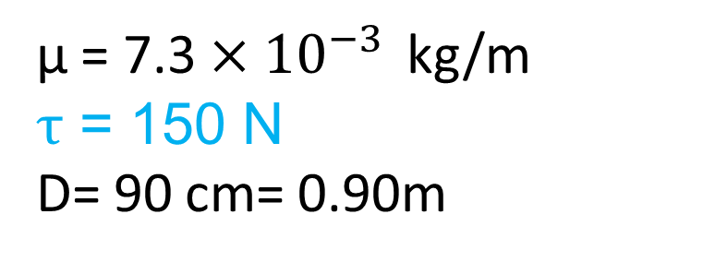

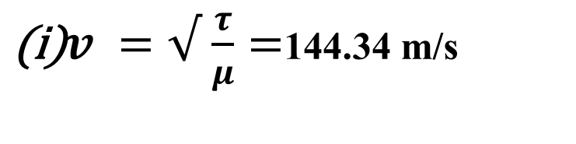
49. A nylon guitar string has a linear density of 7.20 gm/m and is under a tension of 150 N. The fixed supports are distance D = 90.0 cm apart. The string is oscillating in the standing wave pattern shown in the adjacent figure. Calculate the (i) speed, (ii) wavelength, and (iii) frequency of the traveling waves whose superposition gives this standing wave.
$v^{ }=√$ $\frac{τ}{μ}=$144.34 m/s
(ii) λ = $\frac{2D}{3}=0.6 m$
µ = 7.3 $×{10}^{−3 }$kg/m
$τ$ = 150 N
D= 90 cm= 0.90m
(iii) V = fλ
f = 240.56 Hz

